Slide 1
Innovation Lab: Team 7- Liquid Measurement Estimation
Luke Harwood, Freda Yang, Phillip Mei, and Amos Li

Slide 2
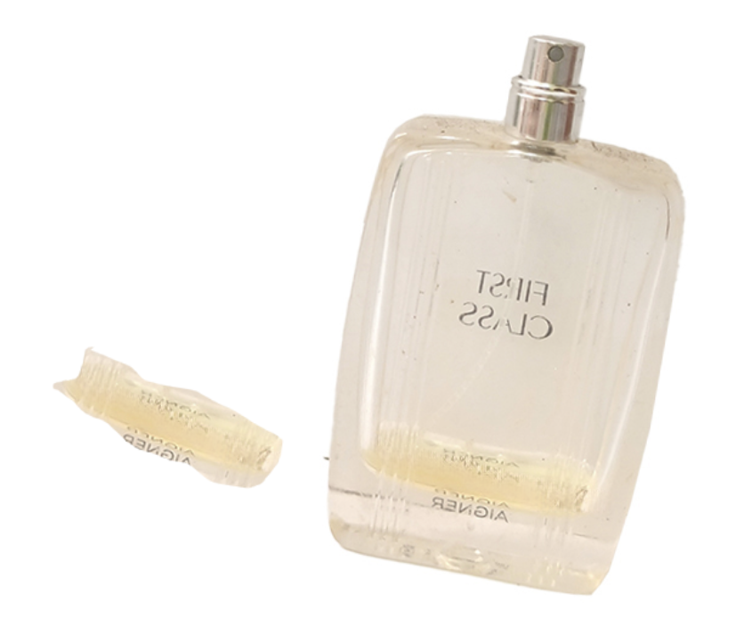
BrainStorm 1: Clustering and Grouping by Colors
Group the image content by colors and use distinct colors to differentiate between the liquid and other components in the image.

Slide 3
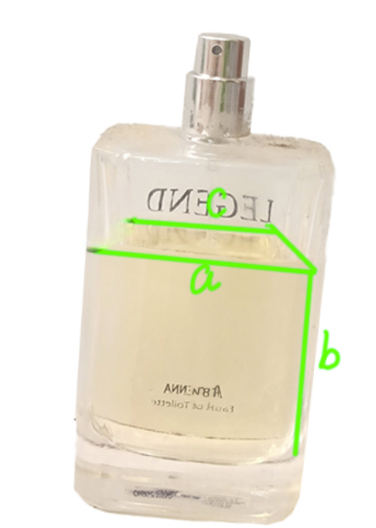
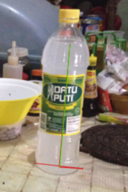
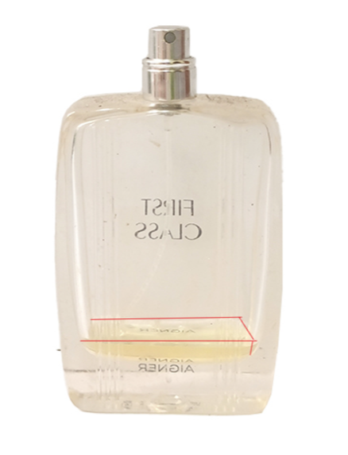
Brainstorm 2: Manual Categorization into two types
Rectangular:
Cylinder:
Measure the liquid's diameter and height.
V=pi*(d/2)^2*h
Measure the liquid's dimensions (width, height, and depth) by identifying four lines.

Slide 4
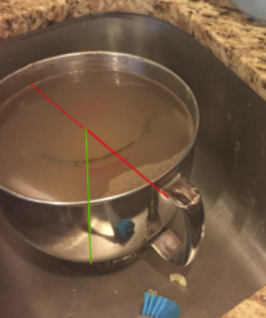
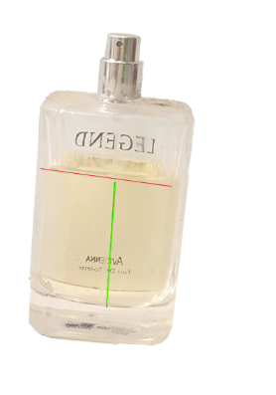
Actual Implementation-only Cylinder: to Label and extract data
We treat all the containers as cylinder
Manually draw the diameter and height of the cylinder with red and green lines
Get the height and diameter in unit of pixel counts

Slide 5
Find number of pixels of height and diameter line
Label and mark the height and diameter of all containers
Find the number of pixels of selected color (pure red and pure green) with a script for our dataset
Manually record the number of pixel for our dataset by the tool of Photoshop

Slide 6
Associate the real side to pixel counting data
Use a beaker (an ideal cylinder) as a container.
Steps to collect and train the data model:
Fill the beaker with a known amount of water.
Take pictures of the water-filled beaker.
Measure the height and diameter of the liquid in pixels using lines on the image.
With the known water volume, create a mapping between the amount of water and the corresponding pixel values for height and diameter.

Slide 7
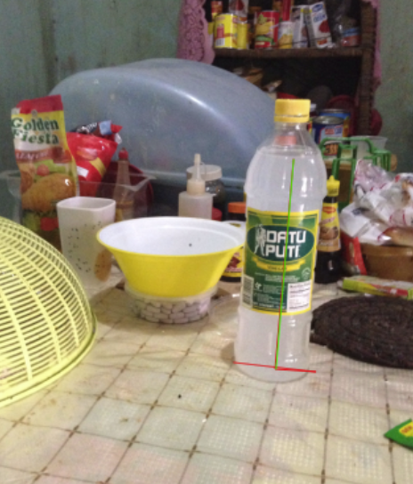
Data Model and Scale Ratio
Train the model using the data collected to get the map of real volume mapping to height and width(in unit of number of pixels).
(pixel values vs. actual dimensions).
Calculate the scale ratio to convert pixel measurements into real-world dimensions.

Slide 8
THANK YOU

